Slide 1




C l a s s i f i c a t i o n
C L A S S I F I C A T I O N
P E R F O R M A N C E A N A L Y S I S
To m a s z J a n e c z k o , L u k á š H of m a n
1

Slide 2


Problem
One of the most important tasks in machine learning is classification, and a model trained to recognize label data points using features. The five different classification methods are analyzed in this project.
In this study, our goal is to find the best-suited method by comparing Precision, Recall, Specificity, False Negative Rate, False Positive Rate, Accuracy, Spatial Accuracy and F-measure providing insight into each model’s strengths and weaknesses.
2

Slide 3
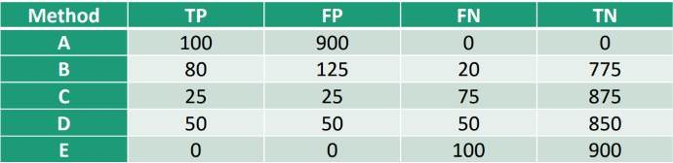
Our dataset
We use the provided dataset from pdf
5 columns: Method TP FP FN TN
TP – True Positives
FP – False Positives
FN – False Negatives
TN – True Negatives
5 Methods: A, B, C, D and E
Number of Samples: 1000
Imbalanced data – only 10% are positives
3

Slide 4
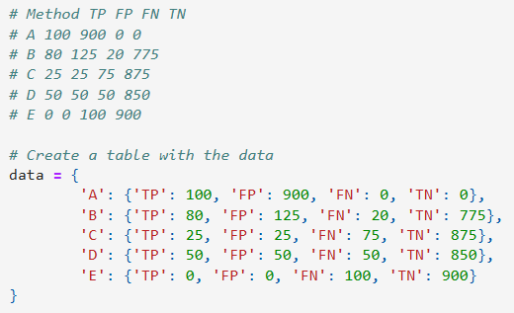
Creation of data
4

Slide 5
Used metrics
In our project, we have used 8 different metrics:
Precision (PR): Accuracy of positive predictions
Recall (RC): Ability to capture true positives
Specificity (SP): Correct negative identification
False Negative Rate (FNR): Proportion of actual positives missed by the method
False Positive Rate (FPR): Proportion of actual negatives incorrectly identified as positives
Accuracy (ACC): Overall correctness of predictions
Spatial Accuracy (S): Focused positive identification accuracy
F-measure (Fm): Balance between precision and recall
5

Slide 6
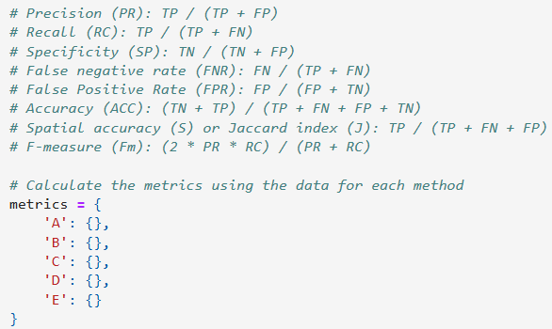
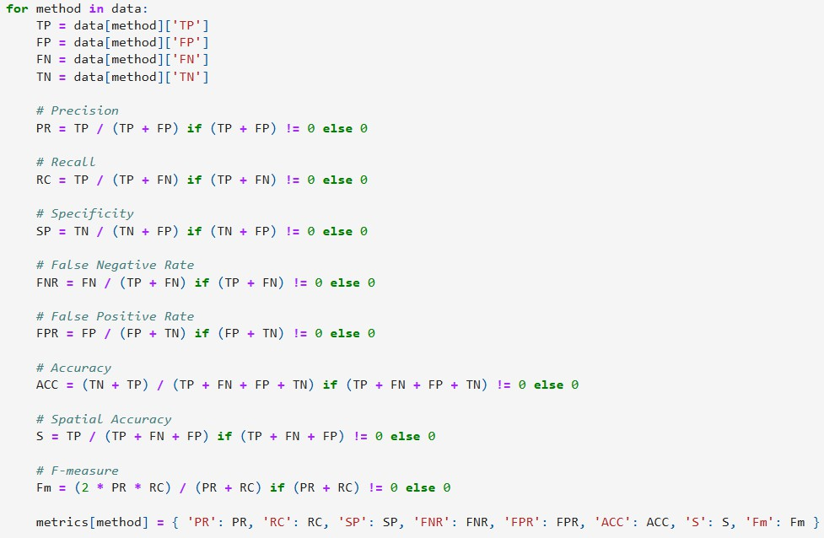
Implementing metrics

Slide 7
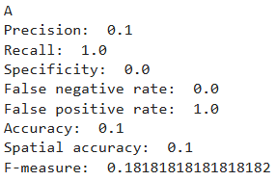
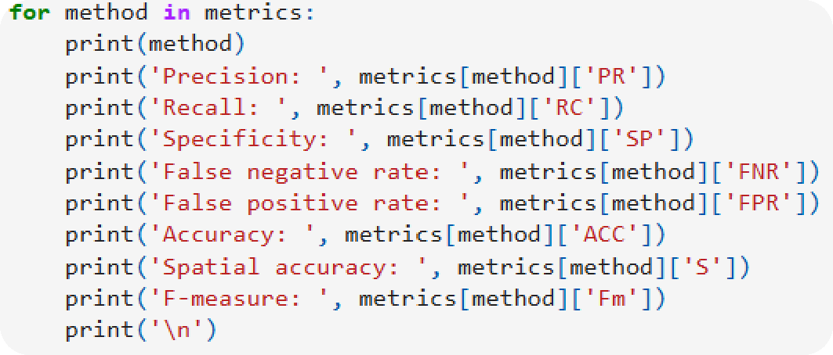
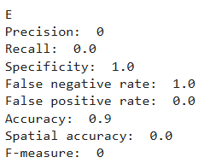
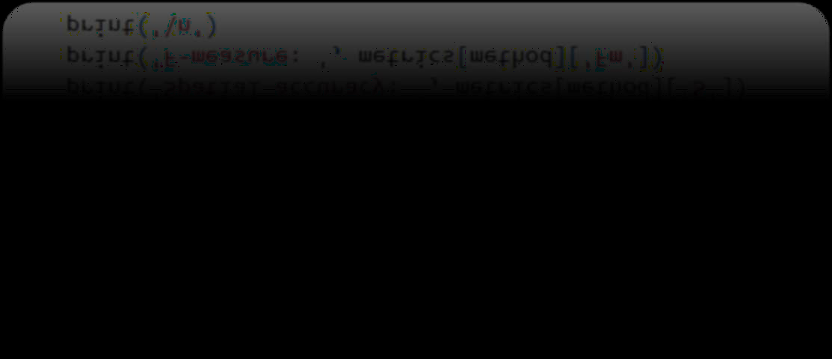
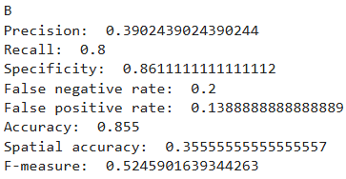
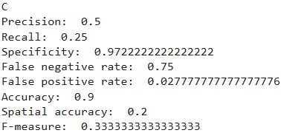
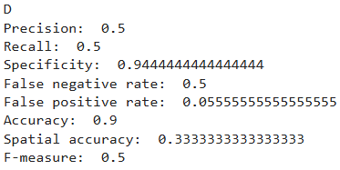
Results for every method

Slide 8

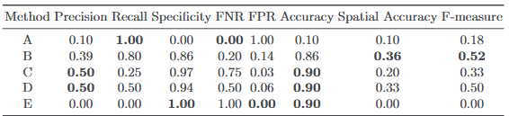
All results in a table
With bold values, we highlighted the most desired values

Slide 9
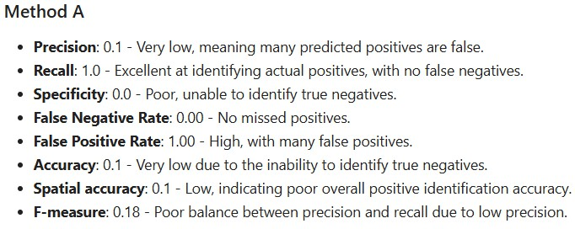
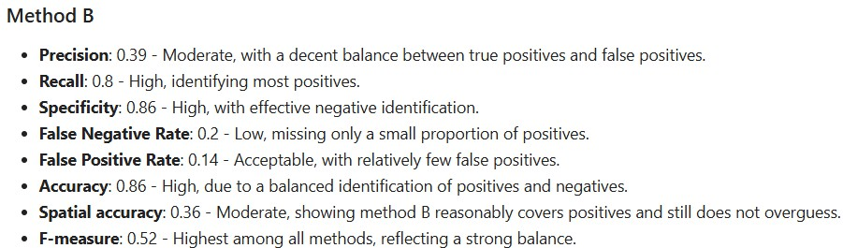
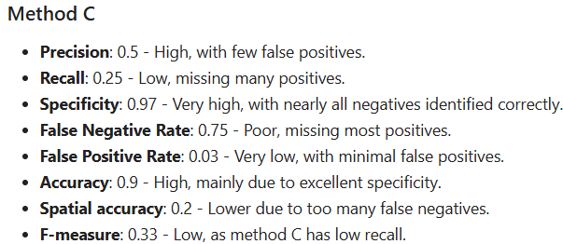
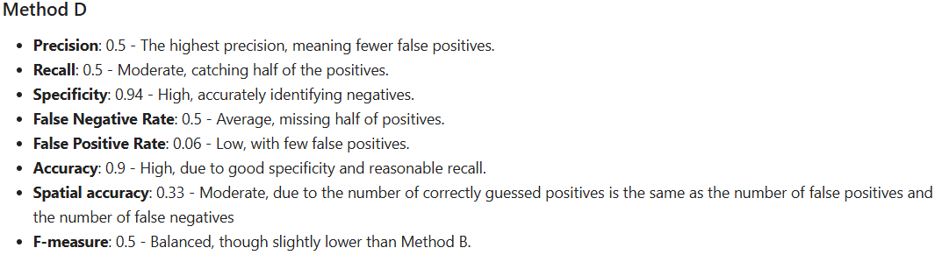
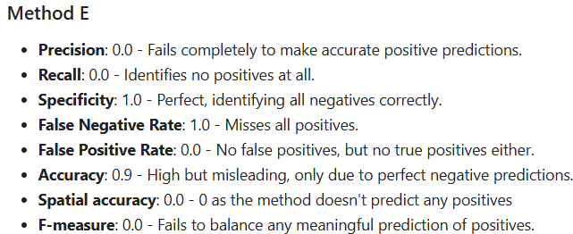
Analysis by each method

Slide 10
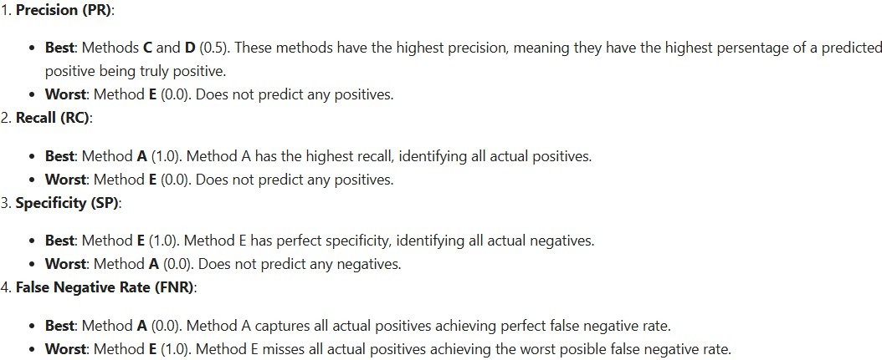
Analysis by performance

Slide 11
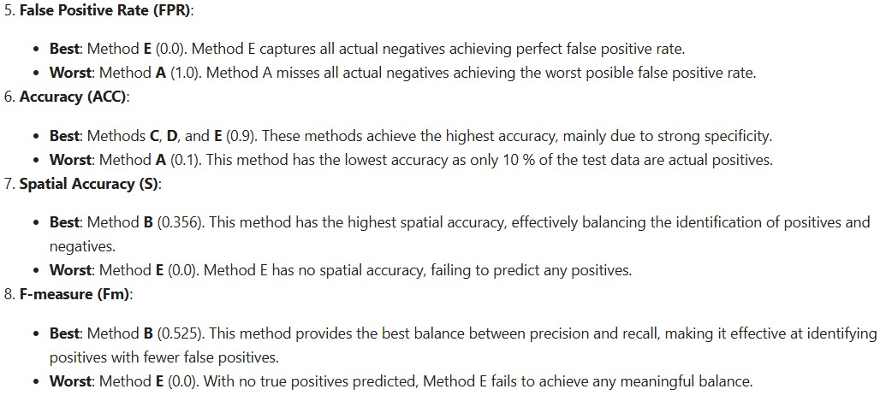
Analysis by performance - cont.

Slide 12
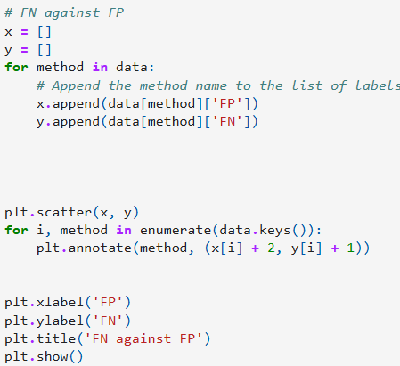
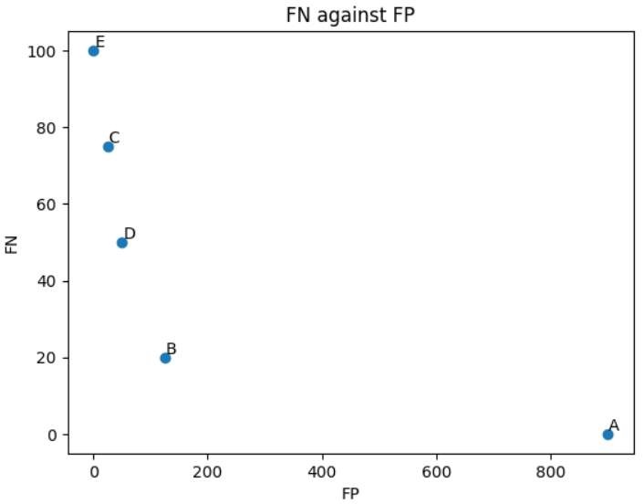
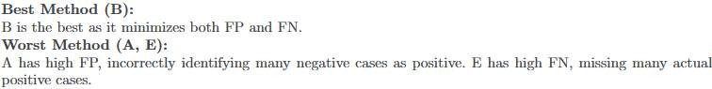
Graph – FN against FP

Slide 13
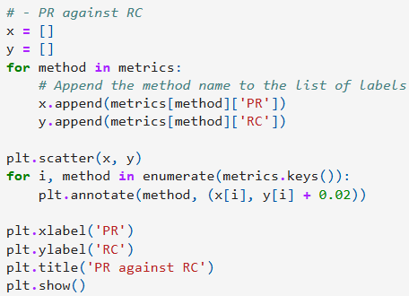
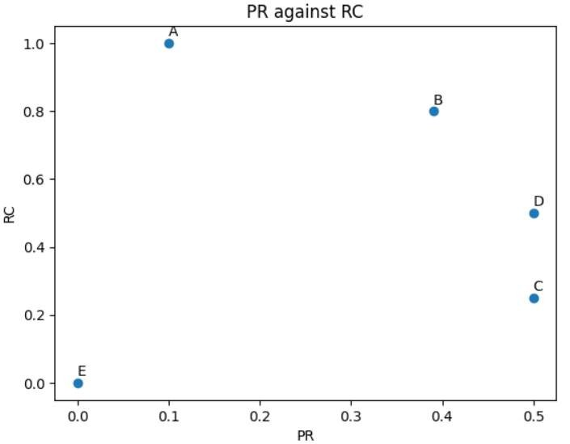
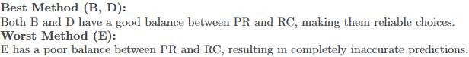
Graph – PR against RC

Slide 14
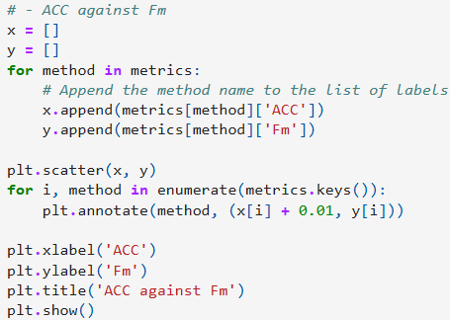
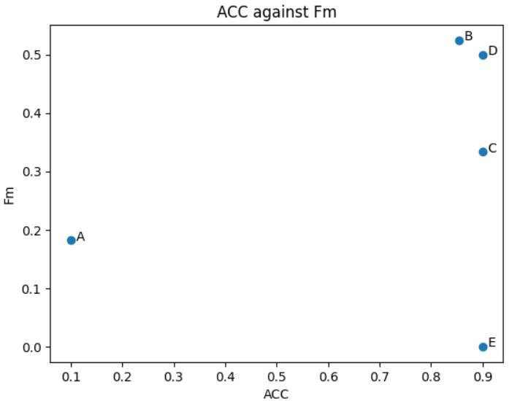
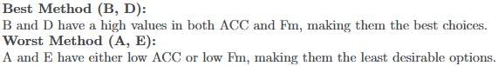
Graph – ACC against Fm

Slide 15


Conclusions
Best method (?):
Method B stands out as the overall best performer, effectively balancing various metrics. It boasts the highest F-measure (0.52), indicating a strong compromise between precision (0.39) and recall (0.8). Additionally, it achieves a respectable accuracy of 0.85. This balanced performance makes Method B a solid choice, capable of accurately identifying positives while minimizing false positives.
Dependence on factors:
The optimal method ultimately hinges on specific objectives. If absolute certainty in positive predictions is paramount, even at the cost of missing some true positives, Method C might be a more suitable option.

Slide 16

Used sources
Slides from Lecture
https://informatica.cv.uma.es/pluginfile.php/654399/mod_resource/content/0/pract%202%20classification.pdf
https://en.wikipedia.org/
https://www.analyticsvidhya.com/articles/precision-and-recall-in-machine-learning/

Slide 17


Thank you for your attention
Co-authors:
Tomasz Janeczko, Lukáš Hofman
https://github.com/LuhiHofi/Aprendizaje
-Computacional
Lab 2A Task
Aprendizaje Computacional (2024-25) Universidad de Málaga
A free PowerPoint template was used
17

